Slide 1

Environmental Report
Federal Aviation Administration

Slide 2
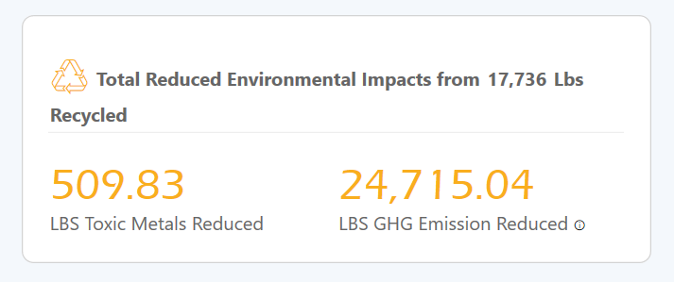
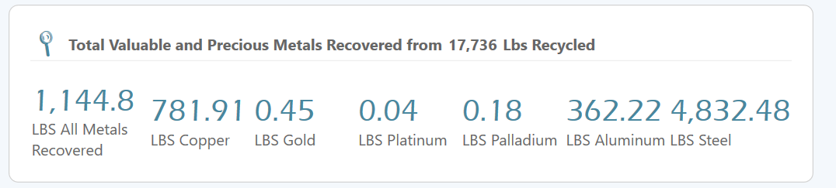
Equivalent to 2 fewer vehicles on the road

Slide 3
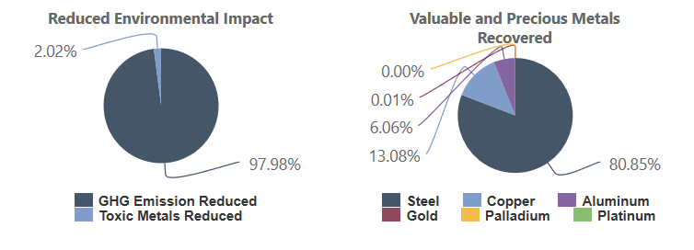

Slide 4
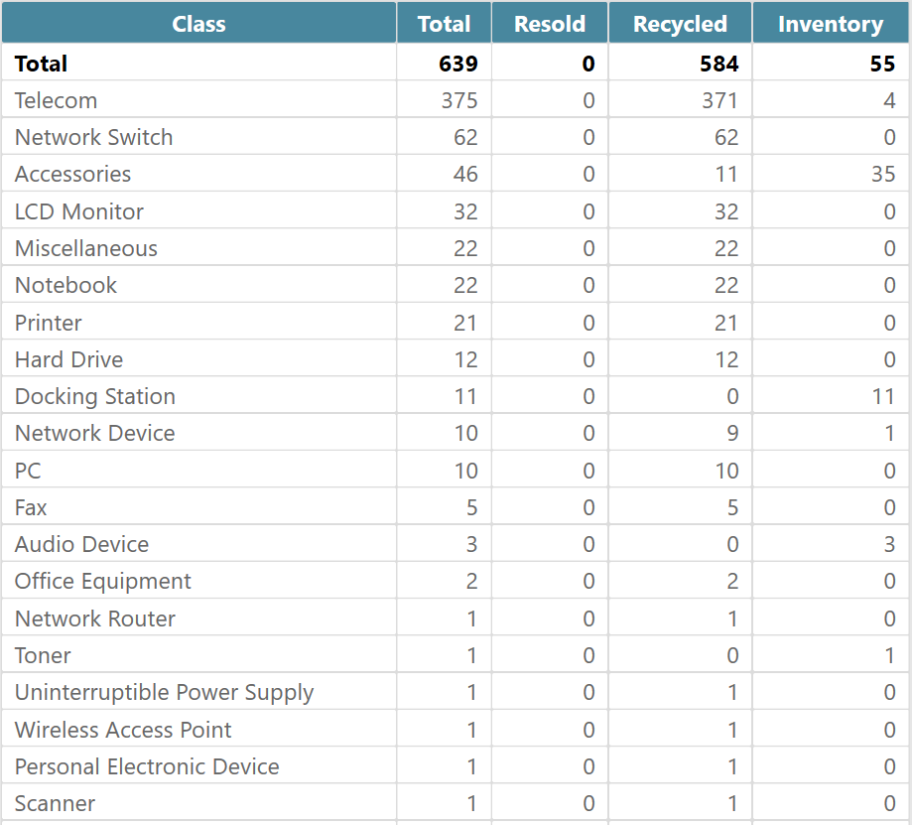
Processed Devices

